Slide 1
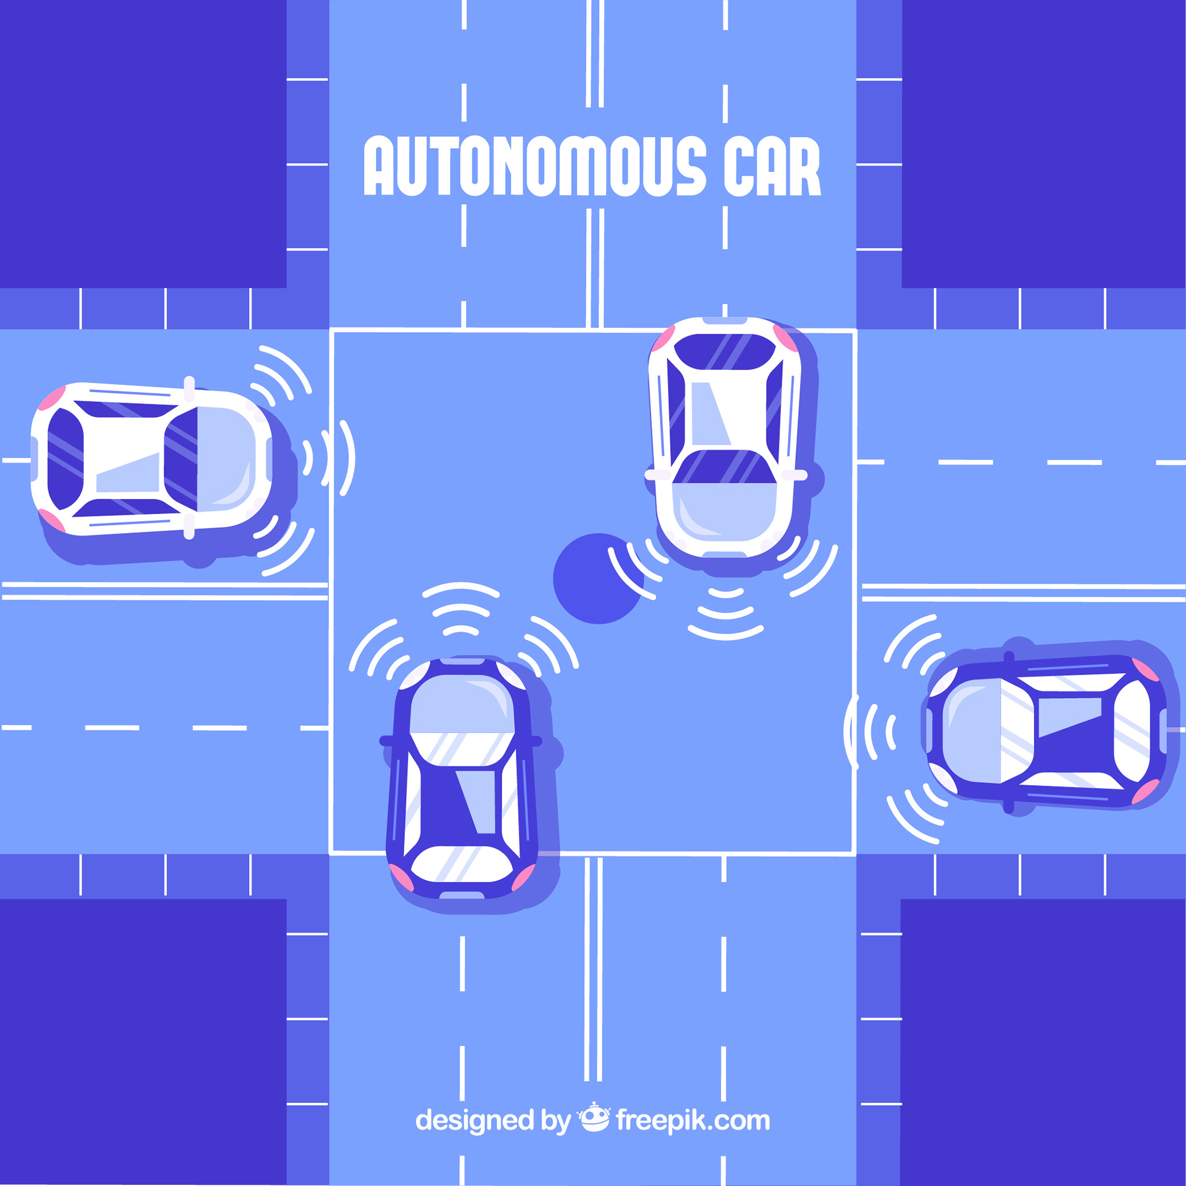
AUTONOMOUS DRIVING
Project by
OMAMAH KHAN

Slide 2
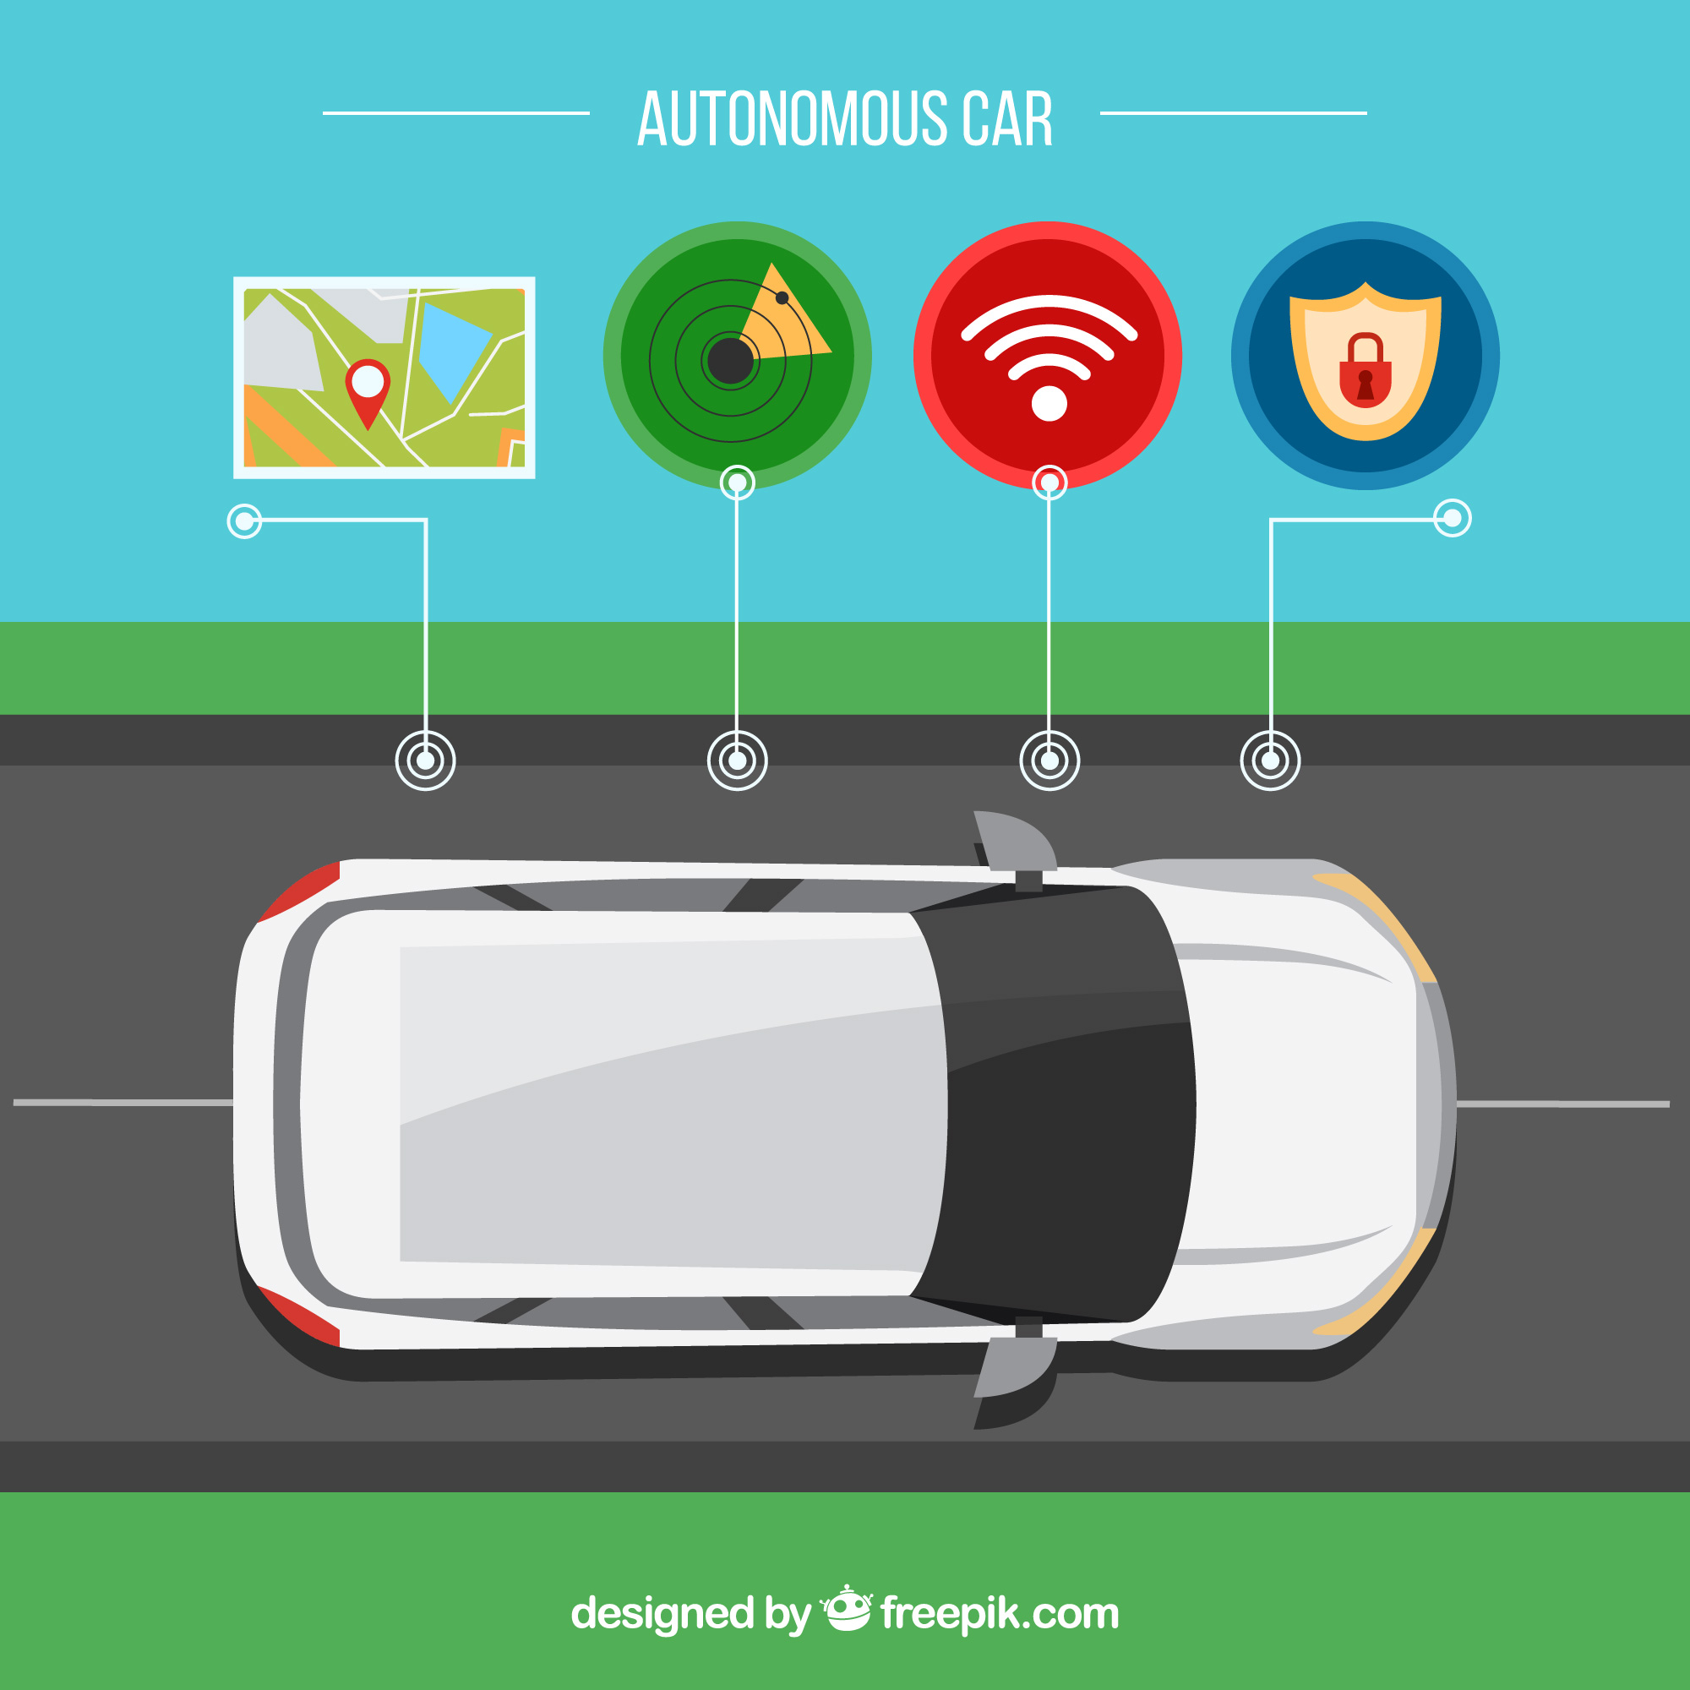
INTRODUCTION
TRANSFORMING THE WAY WE TRAVEL
KEY TECHONOLOGIES
Cameras
Radars
GPS tracking
AI techonology
TYPE
Commercial vehicle
Public transportation

Slide 3

PROBLEM STATEMENT
ALGORITHEM
Navigation on varying weather condition.
APPLICATION
Software is ready implementation is pending .
DEVELOPERS
Developers unity
BUDGETS
budgets friendly

Slide 4

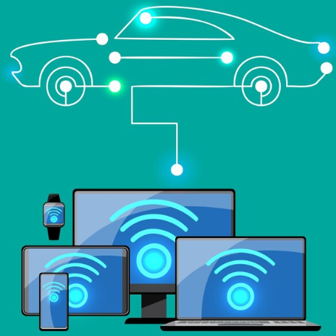
KEY FACTORS
AIDS The drivers
Follows laws
Replace costly fuels and gases
Is specified
Environment friendly

Slide 5

TARGET AUDIENCE
Software engineers
Automotive engineers
Test engineers
Robotic engineers

Slide 6

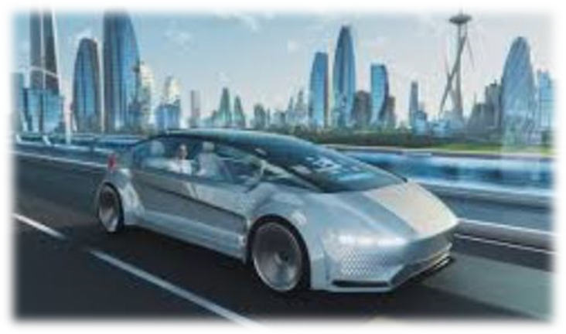
LANGUAGE USE
C++ language
Classes and objects use
High level developers
0 errors

